Slide 1
10 WAYS TO SIMPLIFY YOUR LIFE USING BANKING TECHNOLOGY
Notes:
10 WAYS TO SIMPLIFY YOUR LIFE USING BANKING TECHNOLOGY

Slide 2
Hidden Slide: Facilitator Preparation Instructions
2
Notes:
Facilitator Preparation Instructions
Familiarize yourself with this entire guide by reading it thoroughly and making notes for yourself in advance of training. Where there are [brackets] you are asked to fill in your own information so that when you are presenting it will seamlessly flow into your own specific information. Also, edit two beginning slides and each handout with your specific contact information in advance.
Icons used in these materials are shown on the right.
Where you see the SAY icon, feel free to read in advance and make notes so that you feel comfortable delivering the information. It is not necessary or recommended to read verbatim.
When you cannot play the videos that are part of this seminar, instead share the content information that is summarized in this guide with the group.
Suggestions for timing are provided for each element of the agenda. Keeping track of time during training is a key responsibility of a facilitator. If you find that some areas take slightly longer or shorter than expected, this is typical. Just ensure you adjust for that in another section.
If questions arise that you cannot answer, acknowledge each as a good question and let the participant(s) know you will research the answer and get back with each person individually after the seminar. Then, be sure to follow up.
<Click to next slide to begin the seminar>
2
Important point for Facilitator to note
Facilitator script (Verbatim)
Restate the key points of an activity or discussion
Information for reference purposes
Ask a discussion question
Show video clip (when possible)
Suggestions for great training delivery

Slide 3
REGIONS FINANCIAL FUNDAMENTALS
This information is general in nature and is provided for educational purposes only. Regions makes no representations as to the accuracy, completeness, timeliness, suitability or validity of any information presented. Information provided should not be relied on or interpreted as accounting, financial planning, investment, legal, or tax advice. Regions encourages you to consult a professional for advice applicable to your specific situation.
All trademarks mentioned are the property of their respective owners, and all rights are reserved. Your bank and/or Regions may not offer one or more of the services or products described in this presentation. If your bank and/or Regions do offer a service or product described in this presentation, fees or other costs may apply in order to use the service or product.
Your mobile phone carrier’s data or messaging fees may apply when you use your mobile phone to use or otherwise access a service or product described in this presentation.
© 2015 Regions Bank.
3
Notes:
3
Regions Financial Fundamentals Disclaimer
Pause for five seconds to allow participants to read the disclaimer.
<click to next slide>

Slide 4
10 WAYS TO SIMPLIFY YOUR LIFE USING BANKING TECHNOLOGY
[Add your name and title here]
30 Minutes
4
Notes:
Welcome
Say: Welcome and thanks for choosing to spend your valuable time learning about simplifying your life using banking technology. My name is [your first and last name]. I am a [position with Regions] from Regions Bank.
(If you are not a banker, share that with the audience and let them know where you work. This will help to set expectations as to the depth of product knowledge you may or may not have.)
[Share a brief anecdote about yourself that indicates your excitement about the session and sets you up as knowledgeable regarding financial issues including banking technology.]
I hope you will contribute to our discussion during the next 30 minutes. I will be asking for your input throughout, and we will have time for all of your questions before we wrap up.
Let’s get started.
<click to next slide>
TIP: Remember, get to know this material in advance so that you can seamlessly deliver it without reading verbatim!
4

Slide 5
AGENDA
Today we will focus on these big questions . . .
How can using banking technology help me simplify my life?
By saving time over traditional banking
By simplifying money management
By knowing what’s happening with my account
By making saving easier
This information is general in nature and is provided for educational purposes only. Regions makes no representations as to the accuracy, completeness, timeliness, suitability or validity of any information presented. Information provided should not be relied on or interpreted as accounting, financial planning, investment, legal, or tax advice. Regions encourages you to consult a professional for advice applicable to your specific situation. All trademarks mentioned are the property of their respective owners, and all rights are reserved. Your bank and/or Regions may not offer one or more of the services or products described in this presentation. If your bank and/or Regions do offer a service or product described in this presentation, fees or other costs may apply in order to use the service or product. Your mobile phone carrier’s data or messaging fees may apply when you use your mobile phone to use or otherwise access a service or product described in this presentation.
5
Notes:
Agenda
Say: Thank you for attending today’s seminar. Our goal for the next 30 minutes is for you to learn more about banking technology and how you can use it can simplify your life.
I am happy to stay after the session for specific questions and I will provide my contact information for anyone who wants a little more information later.
<click to next slide>
5

Slide 6
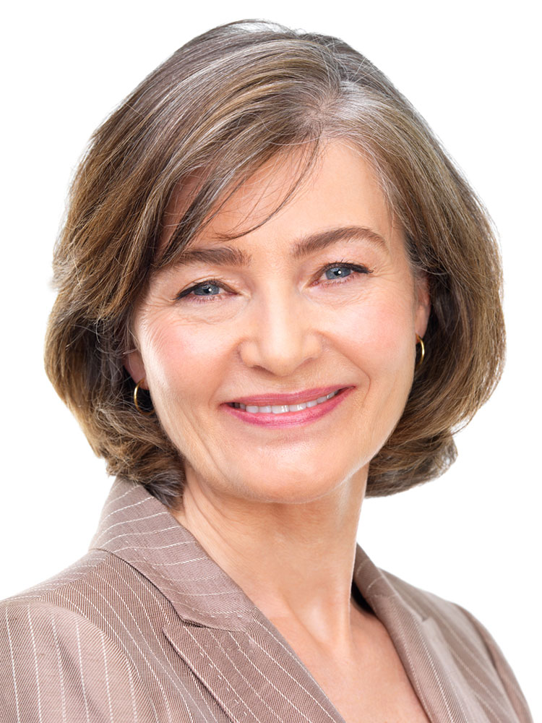
Knowledge is power
Organization is key to money management
Convenience is the name of the game
6
6
Notes:
Knowledge. Organization. Convenience.
Say: Today, we will talk about ten easy ways to use banking technology to simplify your life. We will cluster our advice into three simple categories: bank, manage, and monitor.
We’ll show you that organization is key to good money management and convenience is the name of the game. You don’t need to be a technology wizard or have the latest gadgets to use banking technology to your advantage.
Please feel free to make notes on your handout if you wish.
Distribute Handout 1—Banking Technology Checklist. Refer to the checklist items as you discuss each. Mention that this handout becomes a list of action items participants will take with them at the end of the seminar.
<click to next slide>
6

Slide 7
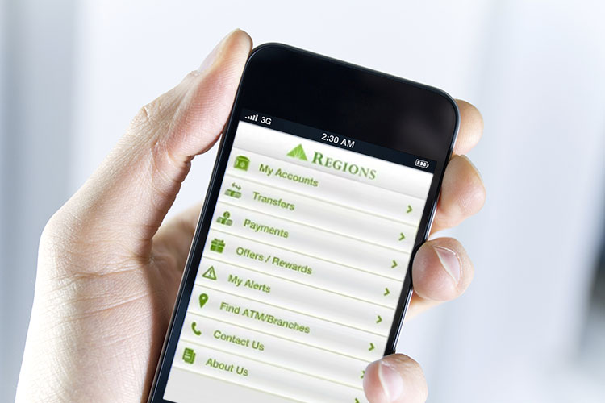
Bank Without Visiting A Branch
7
Notes:
Bank Without Visiting a Branch
Distribute Handout 2—Banking Tips to Simplify Your Life.
Say: Let’s start with ways you can bank today without going into a branch.
One of the biggest benefits of using technology for your finances is the amount of time you can save over traditional banking. Let’s talk more about ways you can simplify your life and save time, while staying on track with your finances.
Follow along with page two of your handout and make notes for yourself on the page next to each tip, if you like.
<click to next slide>
7

Slide 8
Use Direct Deposit
8
Notes:
#1-- Use Direct Deposit
Say: If your employer offers it, enroll in direct deposit. It’s convenient and can help eliminate trips to the bank.
Direct deposit is an electronic transfer of funds from an organization such as your employer, a retirement plan or the Social Security Administration. A direct deposit can help you save time and is a convenient way to ensure your funds are available as soon as possible.
Ask: What are some benefits of direct deposit that you have experienced or can think of? I’ll start with one. For jobs where it is hard to get away from work, such as those shown here, it can be a huge benefit.
Debrief all ideas offered and be sure the following are mentioned:
Convenience. No driving to the bank to deposit your paycheck.
Quicker funds availability. Usually authorized a day in advance, allows you access to your money earlier.
Promotes savings. Having cash in hand (as opposed to it being out of sight and mind) can result in overspending.
Reliability. When you are away (such as when on vacation), you will not need to make special arrangements to get your paycheck, your money will be direct deposited into your account.
Can download into many financial management software packages.
Plus, not carrying large amounts of cash gives you peace of mind.
<click to next slide>
8

Slide 9
Use Bill Pay Options
9
Notes:
#2-- Use Bill Pay Options
Say: Getting started is easy if your bank offers an automated bill pay option. You will want to work with your bank—either in person or online—to register the bills you want to pay and the accounts you want to use to pay them. You can always make changes and add or subtract bills. Automated bill pay allows you to:
Initiate fast and easy payments.
Handle monthly bills without writing checks.
Make one-time payments or set up recurring payments. If a monthly bill is for the same amount each month, (like a mortgage or car payment) you might want to schedule a recurring payment. If the amount varies from month to month you can pay the bill each month on a "one time" basis.
Be in control of your payment date and make sure bills are paid on time to avoid late charges.
Conveniently review payment history, pending payments and payment status if your bank offers online viewing.
You can even set up payment reminders!
Ask: What is appealing to you about being able to pay bills automatically?
Get 1-2 responses before moving on.
<click to next slide>
9

Slide 10
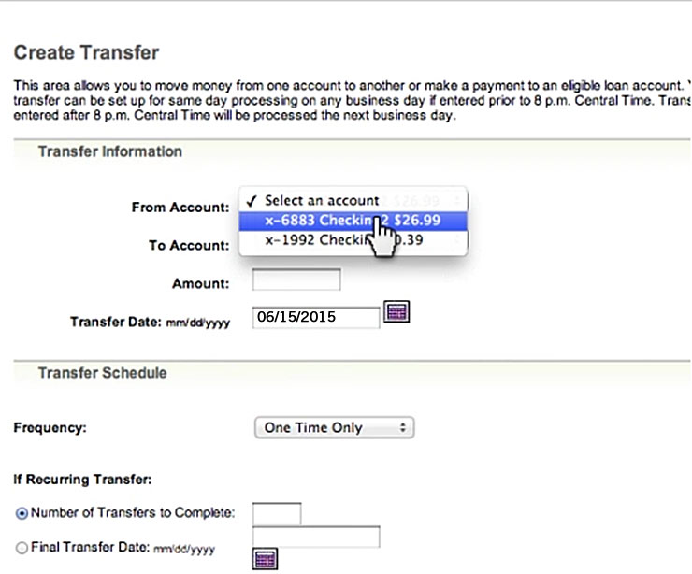
TRANSFER AND SEND MONEY
10
Notes:
#3-- Transfer and Send Money
Say: There are times in life when it’s helpful to be able to transfer money between accounts. Transferring money is easy with online banking. Assuming the accounts are with the same bank, simply choose the account you would like to transfer from and the account you would like to transfer to from the list of your eligible accounts.
Select an amount to transfer and the date you would like the transfer to take place. You can do this once or…
You can make any transfer a recurring transfer by choosing a frequency and keying in the number of transfers you would like to schedule.
You can also send money to friends and family safely, securely and quickly with online and mobile person-to-person payments.
Just be sure you know how often you can transfer money without incurring any fees and/or costs and/or having your account type changed from interest-bearing (if applicable) to non-interest bearing.
<click to next slide>
10

Slide 11
Set up alerts
Deposit checks
Find ATMs or bank branches
Use Your Smartphone!
Your mobile phone carrier’s data or messaging fees may apply.
11
Notes:
#4-- Use Your Smartphone!
Say: With your smartphone you may be able to set up alerts on your accounts via text message and email for transactions, real-time balances, and more! In fact, checking your balance online can help you quickly identify fraudulent charges made against your account.
Another thing you may be able to do with your smartphone is deposit checks in a flash! Typically, this is more convenient than depositing checks in the branch or ATM. Check with your bank about any fees.
Here’s how it usually works. Using a mobile device, take photos of the front and back of your check and submit them through your bank’s app. You’ll get a confirmation on your phone for each successful deposit into your eligible checking or savings account. The bank will also send a deposit confirmation to your primary email address and your online banking secure mailbox.
While on the go you can also use your mobile device or smartphone to find ATMs or bank branches.
Ask: What are some financial situations where setting up an alert on your account(s) might be helpful?
Debrief all answers as correct, however emphasize these key points:
Check accuracy of expected deposits
Keep track of your spending
Identify fraudulent use of your account
<click to next slide>
11

Slide 12
Manage Your Money
12
Notes:
Manage Your Money
Say: Our second cluster of banking technology that can help you simplify your life is grouped around the theme Manage Your Money. Simplify your life by simplifying the way you manage your money. Use banking technology to help you feel safe and secure regarding your finances.
Ask: We’ve talked about how banking technology can free us to do other things. Let’s talk about the opposite perspective for a minute. What concerns do you have about not doing your banking the “old fashioned” way?
Debrief concerns as they arise including:
Theft of money and my sensitive data
Not being able to “see” where it goes
Trusting people I don’t know with my money
No paper trail
My own lack of expertise with technology (might ‘mess things up’)
Fear of new and different things (“I don’t know how to do it and I don’t want to be practicing with something as important as my finances”)
<click to next slide>
12

Slide 13
Manage Your Finances Online
Create a budget
Set up savings and pay off goals
Use online calculators
13
13
Notes:
#5– Manage Your Finances Online
Say: Minimize the time you spend balancing your checkbook with Regions My GreenInsights or personal financial management tools that are available through your bank. Offerings will vary from bank to bank, so I’m going to share the features available from Regions.
In addition to the online banking capabilities mentioned earlier in this presentation—such as checking account balances, paying bills and transferring funds--you’ll also be able to manage your finances with My GreenInsights.
It provides tools to help you successfully manage and track your finances—all online.
You can see all your finances—including accounts at other financial institutions—in one location.
You can use simple charts and automatic categorization to build you budget, follow your cash flow and identify ways to save.
You can set up and meet savings and payoff goals.
You can set up alerts to update you about your spending goals and more.
You can use online calculators.
Ask: How many of you do some portion of your banking online today? Do you use your bank’s personal financial management tool? What do you like about it?
Accept all answers as correct and reiterate benefits as appropriate.
<click to next slide>
13

Slide 14
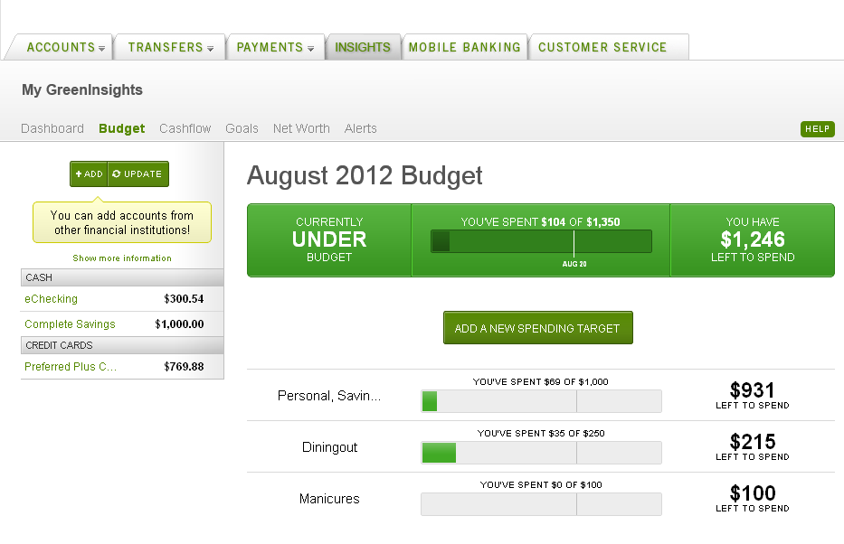
CREATE A BUDGET
May 2015 Budget
14
Notes:
#7-- Create a Budget
Say: Financial experts generally agree that a budget is a basic tool of financial management. Yet, many of us don’t have a budget and without it, a person can more easily lose track of spending.
By creating a budget using My GreenInsights, which is free for Regions customers, all of your spending begins to take form. As you spend and save money, you can easily see how you're doing with what you've budgeted.
Many banks provide the tools to help you successfully manage and track your finances! Through My GreenInsights Regions can help you to:
Create a budget
Set spending targets
Receive progress updates via text or email
Identify ways to save more
At Regions, we'll also allow you to track your upcoming bills and income, which can help you to achieve your personal financial goals! Make managing your money enjoyable, informational and effective. It's easy, safe and secure. Best of all, it's 100% free! You've got nothing to lose, only money to gain!
Refer to the Insights tab on Regions.com for how to improve your money management.
<click to next slide>
14

Slide 15
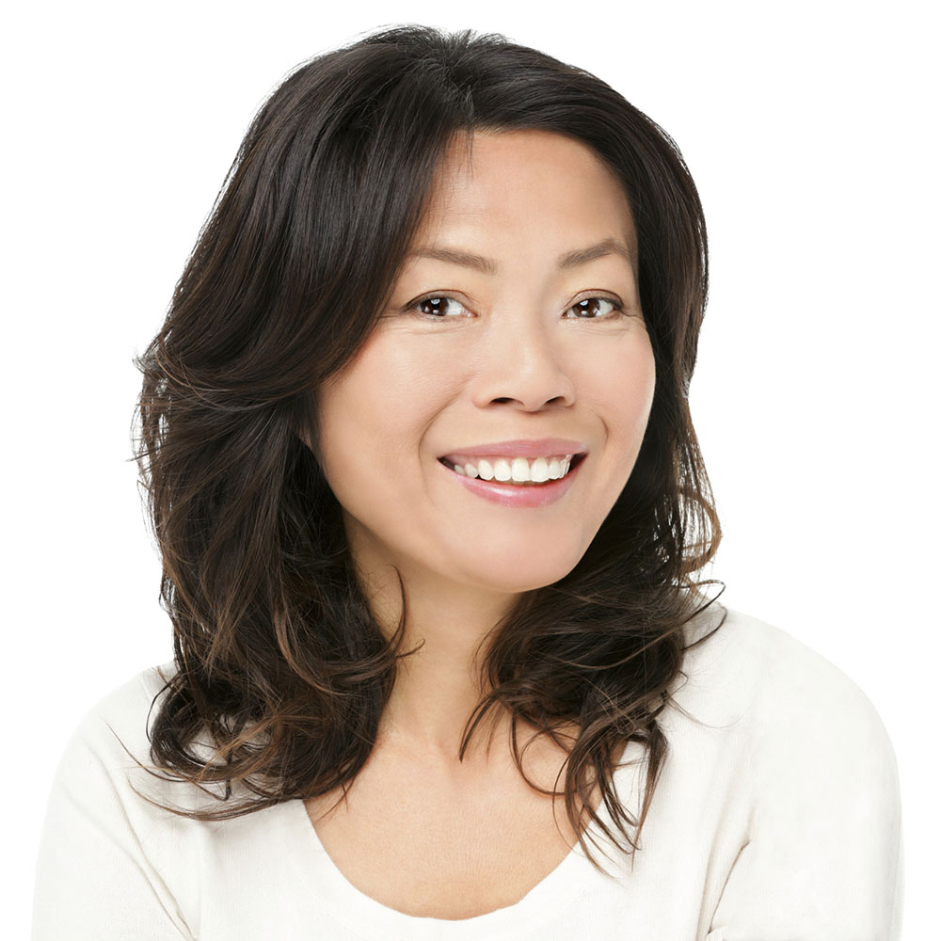
protect
yourself from overdrafts
15
Notes:
#6-- Protect Yourself from Overdrafts
Say: Monitoring your cash flow online can help you stay on top of your available balance, but life can get busy. Forgetting to record a check or debit and then spending money that you don’t have in your account can easily happen to anyone.
For greater peace of mind, consider applying for an overdraft protection product to link your checking account to a deposit account, credit line, money market account or credit card.
Then, if your account is overdrawn, overdraft protection will automatically transfer money to cover the transactions (assuming funds are available in the linked account, of course). The transfer fees are usually less than the overdraft fees.
You can also manage your Standard Overdraft Coverage options and “Opt in” or “Opt Out” through online banking.
Check with your bank about for costs associated with overdraft fees. Using a line of credit or credit card will subject you to interest for drawing on those lines.
<click to next slide>
15

Slide 16
Easily Monitor Your Accounts
16
Notes:
Easily Monitor Your Accounts
Say: Our third cluster of banking technology that can help you simplify your life covers ways to Easily Monitor Your Accounts.
You can know what’s happening with your accounts every day by monitoring them using banking technology. And who couldn’t use a little of that?! There are many ways that using technology tools can take the hassle out of monitoring your finances. Let’s take a look.
<click to next slide>
16

Slide 17
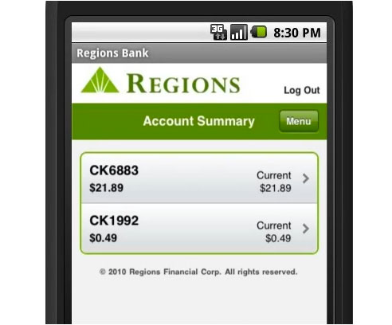
CHECK YOUR BALANCES
17
Notes:
#8-- Check Your Balances
Say: The ability to monitor money is important when you care about where you stand financially. By checking your balance you'll know if you can afford that next purchase.
With traditional banking, if you want to know how much money is in your account, you'll have to visit a bank teller or your bank's ATM, or you can make a phone call to a customer service number. With online banking, all of that information is at your fingertips simply by visiting your bank’s website. 24/7!
With My GreenInsights, which is free to Regions customers, you can check all of your account balances online via your one Regions online banking login. And we do mean all. You can now add accounts you hold at other banks to your Regions My GreenInsights using the free account aggregation service.
Did you know that at Regions, you can check your bank balance several ways without ever going to the bank or ATM: Voice, Online, and Mobile Smartphone App. Many banks offer account information, such as account balance, via text message. This method is rising in popularity. Keep in mind that your mobile phone carrier’s data or messaging fees may apply.
Ask for questions and take time to answer any that have arisen to this point.
<click to next slide>
17

Slide 18
Opt for eStatements
No need to wait for the U.S. Mail.
Receive an e-mail reminder when your statements are ready for viewing.
Because you bypass the home mailbox, you prevent possible mail theft, a common starting point for ID theft.
Choose to print statements or download them to your personal computer.
Reduce clutter.
View past statements.
18
Notes:
#9-- Opt for eStatements
Say: Conveniently access bank statements online.
If you opt for Regions eStatement, you can also access bank statements (on all your accounts) anytime online. It's fast and free, and it eliminates receiving printed statements in the mail each month — saving paper, envelopes and time. Want more reasons to switch to electronic statement delivery at Regions?
Review the benefits listed on the slide:
No need to wait for the U.S. Mail.
Receive an e-mail reminder when your statements are ready for viewing.
Because you bypass the home mailbox, you prevent possible mail theft, a common starting point for ID theft.
Choose to print statements or download them to your personal computer.
Reduce clutter.
View past statements.
<click to next slide>

Slide 19
Check Credit Reports and Score Annually
Request a FREE annual credit report:
Submit a request online at www.annualcreditreport.com
Call toll-free: 1-877-322-8228
19
19
Notes:
#10-- Check Credit Reports and Score Annually
Say: The three largest nationwide credit reporting agencies are:
Equifax
Experian
TransUnion
These agencies, and others like them, receive information from creditors, usually monthly, about whether consumers (including you) are making loan and credit card payments on time. Each agency has its own scoring models. Knowing how these scores are calculated can help you work to improve yours, if necessary.
Your credit score is based on the information in your credit report. Sometimes referred to as a credit rating or Fair Isaac Corporation (FICO) Score—it is a number that helps lenders determine how much of a credit risk a consumer may be.
Check your credit report from each of the three agencies as well as your credit (FICO) score every year. You can obtain a free annual credit report from www.annualcreditreport.com or by calling 1-877-322-8228.
Consider picking a date and using it as a tickler to remind you each year. You know how many people replace the batteries in their smoke detectors when we change the clocks for Daylight Savings time? You might decide to ring in the new year with clarity about your credit situation or celebrate your birthday by knowing your credit score. The date you choose is up to you.
<click to next slide>
19

Slide 20
Make Saving Easier
20
Notes:
Make Saving Easier
Say: This wraps up 10 Ways to Simplify Your Life Using Banking Technology, but I have two quick technology bonuses for you.
There are simple ways technology makes it easier for you to save for a car, a college education, retirement or even a dream vacation. In a minute we will talk specifics about how that can work in your favor.
<click to next slide>
20

Slide 21
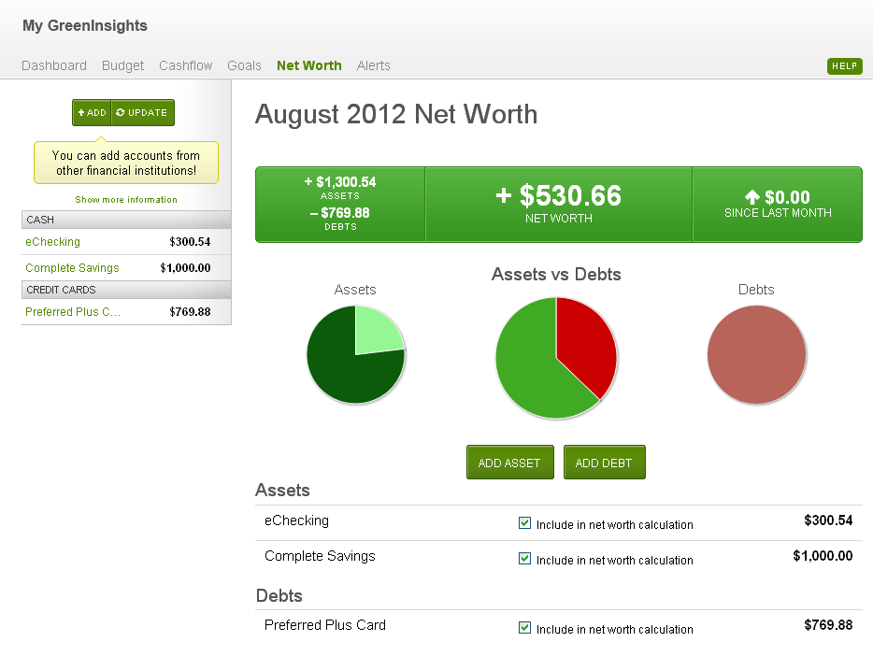
AUTOMATE SAVINGS
August 2015 Net Worth
21
Notes:
Bonus #1-- Automate Savings
Say: The first bonus tip is to automate your savings.
It’s a good practice to pay yourself first. Set up an auto debit from your checking account to your savings account each payday. Whether it's $50 every two weeks or $500, don't cheat yourself out of a healthy long-term savings plan. Regular, automatic transfers to a savings account add up over time. Regions My GreenInsights makes it easy.
Just think, if you set your checking account to automatically transfer $50 or $100 every pay period from your checking to a special savings account that is strictly off limits. Within a year, you've saved $1,200 to $2,400!
Best Practice: You may want to adjust the suggested dollar amounts above to your reflect the appropriate goals for your audience.
<click to next slide>
21

Slide 22
Set up SAVINGS GOALS
22
Notes:
Bonus #2-- Set Up Savings Goals
Say: The second bonus tip is to set up savings goals.
One of the best ways to save money is by visualizing what you are saving for. If you need motivation, set saving targets/goals along with a timeline to make it easier to save.
Have college tuition to pay for?
Want to buy a house in three years with a 20 percent down payment?
Thinking down the road to retirement?
Take a moment now to think about targets or goals you might want to save for. Maybe you can think of MORE than one!
Now you have a target and know what you will need to save each month to achieve your goal. Setting up your savings goals in My GreenInsights is easy and helps you monitor progress toward your goal. Use online calculators to help you determine the finish line so you can achieve your goals!
<click to next slide>
22

Slide 23
Congratulations
Today, you will leave with:
Tips and tools for using banking technology to simplify your life including…
A checklist of action items for you follow up on
Banking tips to simplify your life
Thank you.
23
Notes:
Congratulations
Say: Today you learned about a dozen ways that using banking technology can simplify your life. Before we leave, let’s talk about how you can use handout 1 to take action on using banking technology to simplify your life. Read over your page one checklist. I recommend you start with one or two items on the list and go from there. Mark the first two items you want to investigate with the numbers one and two now.
Thank you for participating in this Regions Financial Fundamentals seminar about Simplifying Your Life Using Banking Technology.
[Be sure to call attention to your contact information on the handouts they are taking with them and invite them to reach out to you in the future.]
Ask: What final questions do you have about anything we’ve covered in the seminar?
Answer all questions as fully as possible.
Say: This concludes the financial wellness presentation. If you have something specific or confidential then please stay after the meeting or contact me at the phone number on your handout or use one of the following channels:
<click to next slide>
23

Slide 24
Want to Learn More About How Regions Can Help You Meet Your Financial Goals?
To make an appointment with a Regions banker:
Call the Regions Green Line at 1-800-REGIONS
Go to regions.com and click “Make an Appointment”
Visit any Regions branch
24
Notes:
More About Regions
Say: How can Regions help you meet your financial goals?
As I mentioned at the beginning of the presentation, I am not a banker.* If you have questions about Regions products and services you can make an appointment with a nearby Regions banker through these convenient ways:
Call the Regions Green Line at 1-800-REGIONS
Go to regions.com and click “Make an Appointment”
Visit any Regions branch
Thank you for participating in this session of Regions Financial Fundamentals.
*(Omit this sentence if you are a banker).
[Remember that the tone and approach should be consultative and friendly. Be sure to call attention to your contact information on the handouts they are taking with them and invite them to reach out to Regions in the future.]
This slide should remain on the screen until the last person leaves the session.

