Slide 1
Entrepreneurship in the Classroom

Slide 2
You Know Your Students Best
The following characteristics and skills commonly associated with successful entrepreneurs:
Comfortable with taking risks
Independent
Persuasive
Able to negotiate
Creative
Supported by others

Slide 3
Entrepreneurship in the Classroom
Louisiana Jump Start Pathways
Business Management
Micro-Enterprise

Slide 4
Entrepreneurship in the Classroom
Complete Curriculums
Money Smart: Small Businesses – FDIC
Money Smart for Grades 9-12: FDIC
Lesson 21: Entrepreneurship 1 “Starting a Business”
Lesson 21: Entrepreneurship 2 “Maintaining a Business”
JA Be Entrepreneurial – Junior Achievement

Slide 5
Classroom Resources
Entrepreneurship
Business Growth Plan
Entrepreneurship Promotion Project
Franchise Business Plan
Innovation Plan
International Business Plan
Start-up Business Plan

Slide 6
Classroom Resources
Courses on Demand
Startup Basics
Defining Your Business Concept
Creating Your Marketing Plan
Financial Projections
Funding Sources

Slide 7
Classroom Resources
Virtual Schoolhouse
Help with Micro-Enterprise Credential
Mentorship

Slide 8
Classroom Resources
Sessions
Introduction to Entrepreneurship
What’s My Business
Who’s My Customer
What’s My Advantages
Competitive Advantage
Ethics Are Good for Business
The Business Plan
Mentorship ~ Small Business Education ~ Completions

Slide 9
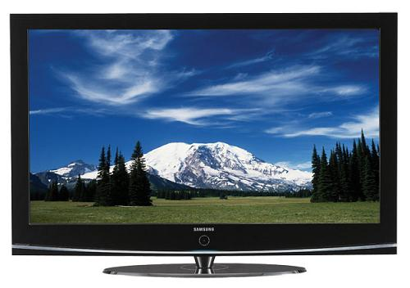
Meet Dominick Ruiz

Slide 10
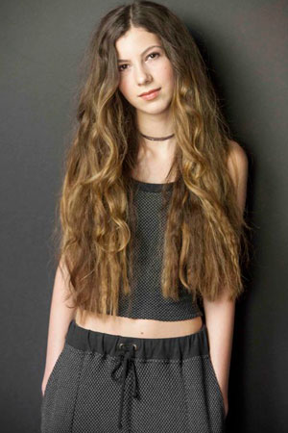
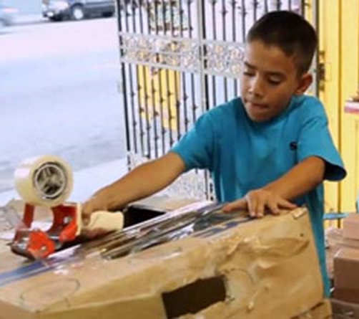
Making Ideas Happen
Caine Monroy
Caine Monroy is only nine years old and already a business owner. He's an arcade owner to be exact.
Raised over $212,000.
Juliette Brindak
Brindak launched her tween social networking site Miss O and Friends (an Inc. Coolest College Start-Up in 2011) when she was only 16.
Company Valued at15m in 2008
Isabella Rose Taylor
At 13 Isabella launched a clothing line with Nordstroms

Slide 11
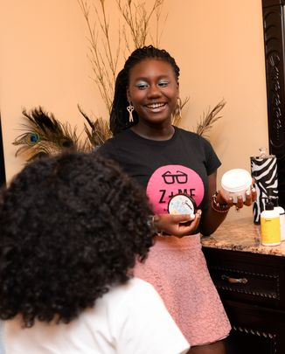
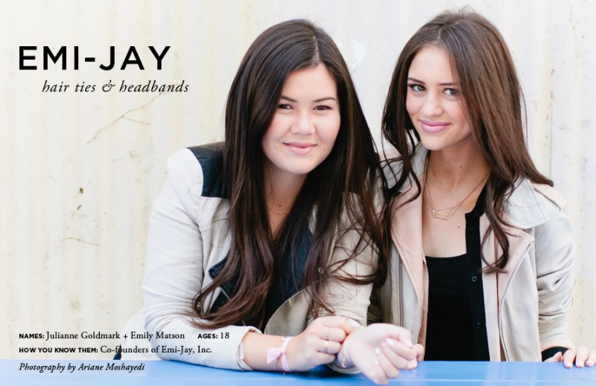
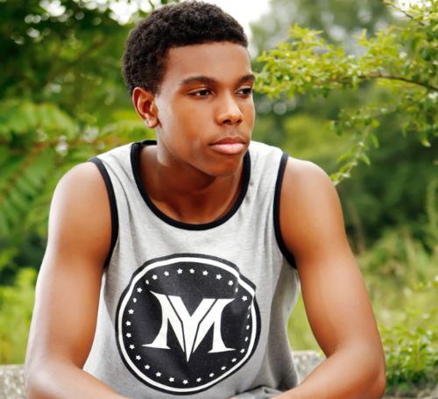
Making Ideas Happen
Brandon Iverson
The Atlanta native launched his first venture with close friend and business partner, Jordan Williams, when they were just 10 years old. “It’s [Kids Toys Inc.] kind of like an online eBay for us, where we sold our old toys and games that we didn’t use anymore.
Zandra Cunningham
her Buffalo-based business, Zandra, sells 37 natural, homemade skin products in stores in six states and online at zandrabeauty.com, Etsy and Amazon.
Emily Matson and Julianne Goldmark
Created elaborate headbeads worn by Manhattan’s social elite and celebs like Jennifer Aniston.
Running multimillion dollar business from their dorm rooms

