Slide 1
Ethics
In Government and Business

Slide 2
Business Ethics
Conflict of Interest- is a situation in which a business owner/employee has an advantage they may exploit to the benefit of business owner/employee or another person at the expense of a customer/client that believes the company is pursuing their best interests.
The business owner can exploit economies of scale to offer the lower price and make similar profit.

Slide 3
Business Ethics
Example:
A client approaches a company for a contract to produce t-shirts. The client submits the design and receives their full allotment of t-shirts as requested. Company then produces more t-shirts without clients consent and sells at a cheaper price than the client after realizing the demand for such product.

Slide 4
Intellectual property
Property that a creator has the legal right to commercialize.
Copyright- writings
Patent- inventions
Trademark- Branding
A person has the ability to license these products.

Slide 5
Non-compete agreements
Important for new companies or companies that have a new or proven formula used to create or maintain their business and client base.
This is protects a company from a rogue or disgruntled employee from exploiting sensitive information gained from being an employee of the company.
Allows company owner to protect their market.

Slide 6
Child labor laws
Sets the wage, hours worked, and safety requirements for minors. Rules vary depending on age and particular job.
Prohibits a minor from working in declared hazardous environments.
State laws may be more protective than the Fair Labor Standards Act.
www.dol.gov for more information

Slide 7
Anti- Trust laws
Conspiring to Fix Market Prices: Discussing prices with competitors, even if it affects a small marketplace, may be construed as a violation of antitrust laws.
Price Discrimination: Using dominant industry power to secure favorable product prices from buyers, even though such prices are unavailable to weaker companies in the same industry, is generally a violation of antitrust laws.
Conspiring to Boycott: Conversations with other businesses regarding the potential boycott of another competitor or supplier may violate antitrust laws.
Conspiring to Allocate Markets or Customers: Agreements between competitors to divide up customers, territories, or markets are illegal. This provision applies even when the competitors do not dominate the particular market or industry.

Slide 8
Best Practices in Advertising and Marketing
Advertising must tell the truth and not mislead consumers.
“You’ll receive a “Toyota” with your purchase” stated on a radio advertisement
Instead you receive a toy Yoda with your purchase.
All claims must be substantiated.

Slide 9
Main focus of the code of governmental ethics?
Is to make sure a person does not use their public office/employment not for private gain
The compensation received from the governmental entity or agency is not included in the private gain.

Slide 10
Who is subject to the Code of Ethics?
Elected & Appointed Officials
Public Servants
Immediate Family Members
Private Entities
(ex. Contracted services)
Legal Entities
(i.e., companies & businesses)

Slide 11
Important definitions
PUBLIC EMPLOYEE is anyone who is:
Appointed by an elected official
Engaged in the performance of a governmental function
Under the supervision or authority of an elected official or another employee of a governmental entity

Slide 12
Important definitions
AGENCY (for a PUBLIC SERVANT)
AGENCY (for an ELECTED OFFICIAL)
is the department, office, division, agency, commission, board, committee, or other organizational unit of a governmental entity
Example: Traffic Police Officer’s agency within the Police Department is the traffic division
is the state or any political subdivision to which the elected official is elected
Example: Police Chief’s agency is the Police Department

Slide 13
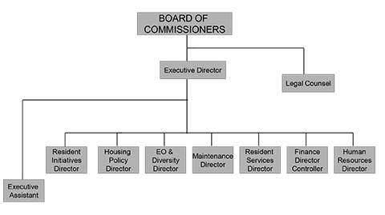

Slide 14
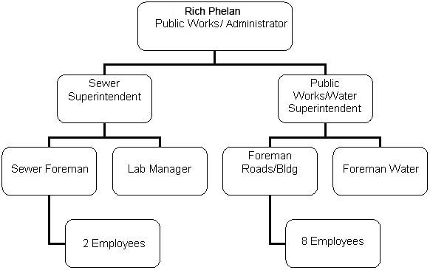

Slide 15
Who are considered my immediate family members?
Parents
Brothers and Sisters
Brothers’ and Sisters’ Spouses
Children
Children’s Spouses
Spouse
Spouse’s Parents
IT DOES NOT INCLUDE YOUR SPOUSE’S BROTHERS AND SISTERS

Slide 16
Prohibited contracts
A public servant or member of his immediate family or legal entity in which he has a controlling interest (greater than 25% combined amongst the family) SHALL NOT bid on or enter into any contract, subcontract, or other transaction that is under the supervision or jurisdiction of the agency of the public servant (1113)

Slide 17
PROHIBITED CONTRACTS
A public servant or immediate family member who receives any thing of economic value from his agency or
through a person who is regulated by his agency
has bid on or entered into any contract, subcontract, or transaction under the supervision or jurisdiction of his agency
SHALL DISCLOSE to the Board income or value received and the nature of the business activity

Slide 18
Prohibited contracts
The amount of the contract is not important, it is still prohibited
You may donate time and money to your own agency
You may want to notify your immediate family due to the potential penalties and fines

Slide 19
Payment from Nonpublic or public Sources
A public servant shall not receive anything of economic value, other than compensation and benefits from the governmental entity to which he is duly entitled, for the performance of the duties and responsibilities of his office or position. (1111A)
This prohibition includes bonuses from governmental entities

Slide 20
Important definitions
PROHIBITED SOURCES for Public Employees:
A person who has or is seeking a contractual, business, or financial arrangement with your agency. (Vendors)
Someone who, for compensation, attempts to influence any legislation or ordinance of the elected body. (Lobbyist)

Slide 21
IMPORTANT DEFINITIONS
PROHIBITED SOURCES for Public Employees:
A person who conducts activities which are regulated by the public employee’s agency
A person who has a substantial economic interest that can be affected by the performance or non-performance of the public employee’s job duties.

Slide 22
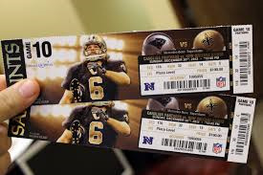
Can I accept gifts?
A public servant SHALL NOT solicit or accept, directly or indirectly, any thing of ECONOMIC VALUE as a gift or gratuity from any person or company that is a PROHIBITED SOURCE (1115)

Slide 23
EXCEPTION TO THE RULE
PROMOTIONAL ITEMS WITH LITTLE VALUE
To be considered a PROMOTIONAL ITEM the item must:
Have the name or logo of the business or organization imprinted thereon
Have minimal value or no substantial resale value
Examples: Pens, T-shirts, Cups, Bags, Hats etc.

Slide 24
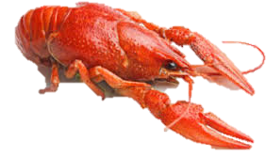
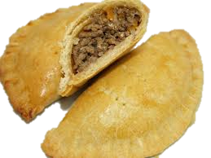
Exception to the rule
Food and drink must be consumed in the presence of the giver or a representative of the company of the giver. (1115.1)
The maximum amount a person can receive per event is $60. This total does not include tax or gratuity.
If it is an event for a group or organization of public servants, then the dollar limitation is calculated by dividing the total cost of F&D by the total number of persons invited.

Slide 25
Can I accept Income from Prohibited sources?
A public servant, public servant’s spouse, or entity which the public servant or spouse exercise control or owns more than a 25% interest
Receive any thing of economic value for services performed or compensated from a PROHIBITED SOURCE excluding people influencing legislation (1111(c)2(d))
MAY NOT
*This includes employment, contracts, and selling property or goods*

Slide 26
Prohibition on nonpublic service
Is devoted substantially to the responsibilities, programs, or operations of the agency of the public servant and in which the public servant has participated
Draws substantially upon official data or ideas which are not part of public record (1111(C)(1))
No public servant shall receive any thing of economic value for any service, the subject matter of which:

Slide 27
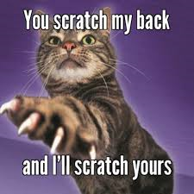
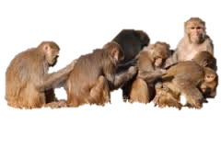
Can I receive Finder’s fees?
NO public servant shall receive any thing of economic value from a person to whom the public servant has directed business of the governmental entity (1111B)

Slide 28
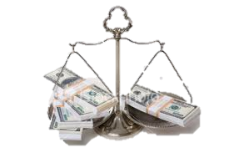
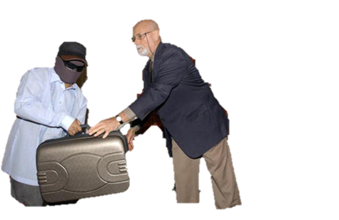
Illegal payments
No public servant or other person shall give, pay, loan, transfer, or deliver or offer to give, pay, loan, or deliver, directly or indirectly, to any public servant or other person any thing of economic value which the public servant would be prohibited from receiving by the Code (1117)

Slide 29
Abuse of office
No PUBLIC SERVANT shall:
Use the authority of his office or position, directly or indirectly, to compel or coerce any person (including other public servants) to provide himself or any other person with any thing of economic value

Slide 30
Actions you should not perform (1112)
A public servant cannot participate in a transaction which:
He
Any member of his immediate family
Any person in which he has a substantial economic interest
Any person of which he is an officer, director, trustee, partner, or employee
Any person with whom he is negotiating future employment
Any person who is a party to an existing contract with the public servant and can affect the economic interests of the public servant.
Has a substantial economic interest involving the governmental entity.

Slide 31
substantial economic interest means…
An interest which is of greater benefit to the public servant or other person than to a general class or group of persons EXCEPT the interest that a person has as a member of the general public

Slide 32
Protecting against participation
ELECTED OFFICIALS
APPOINTED OFFICIALS
Must recuse themselves from voting but MAY participate in the debate or discussion
Must recuse themselves and CAN NOT participate in the debate or discussion
*Public employees must disqualify
themselves. Set up a disqualification plan.

Slide 33
Important definitions
AGENCY HEAD
Means the chief executive or administrative officer of an agency or any member of a board or commission who exercises supervision over the agency
Elected officials are agency heads

Slide 34
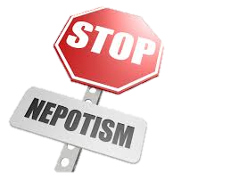
Nepotism
No member of the immediate family of an agency head shall be employed in his agency
Exception to the rule:
When the immediate family member has been employed by the agency for at least one year prior to the immediate family member becoming the agency head
Employee can still be promoted and advance within the agency

Slide 35
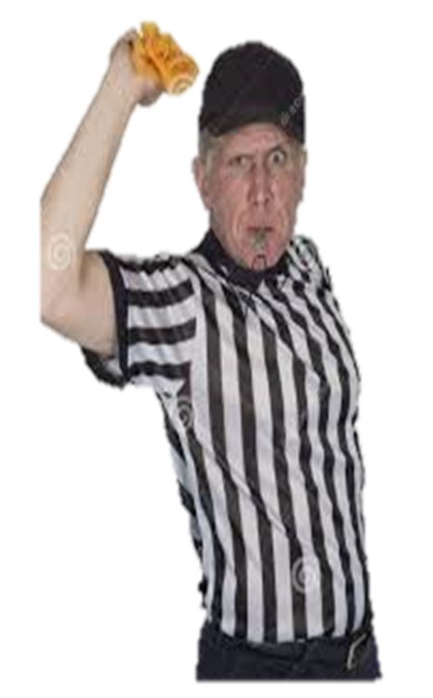
PENALTIES AND FINES
Censure
$10,000 per violation
150% of the economic advantage
Cancel or rescind contract
Forfeit gifts or illegal payments
Remove, suspend, or order a reduction in pay or demotion of the public employee

Slide 36
Post-employment restrictions
No former public employee shall assist another person, for compensation, in a transaction or appearance in connection with a transaction in which the former public employee participated at any time during his public employment and involving the governmental entity by which he was employed for two years following termination of public service
Also can not render any service that you performed for the former agency to former agency on a contractual basis for two years

Slide 37
Website and contact info
For more information check out our website www.ethics.la.gov
If you would like informal advice you can contact our offices at
(225) 219-5600 or (800) 842-6630.

